Slide 1
Lecture 02
Water Resources Systems
Modeling
Notes:
https://snu-ac-kr.zoom.us/j/84027051484?pwd=aU5OZitOKzUyRW9DQ0s0TkpIMSs4UT09

Slide 2
Review on Lecture 01
Overview of WRSA
A water resources system is the whole made from connected hydrologic, infrastructure, ecologic, and human processes that involve water. (Brown et al. 2015)
WRSA-- “Wicked” Problems?
“Defining the problem is the problem itself”
23 Unsolved Problems in Hydrology (UPH)
“Why” “What” & “How” questions
Real-world Example of WRSE problem: 보령 다목적댐
Future of WRSA? (Reed & Kasprzyk 2009)
Constructive Modeling … Interfaces with society

Slide 3
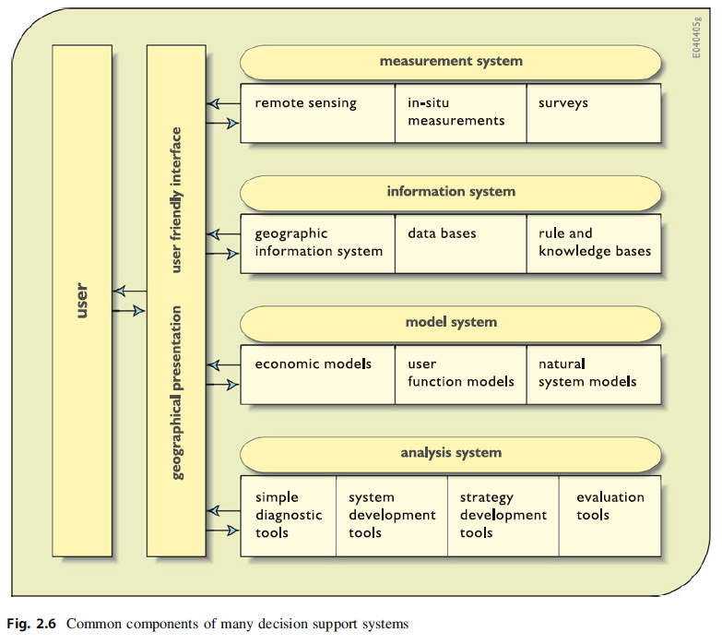
Before Lecture 02
Acronyms (약어)/Keywords in Lecture 02
DSS: Decision Support Systems (의사결정 지원 시스템) = computerized program used to support determinations, judgments, and courses of action in an organization or a business
SVP: Shared Vision Planning
SVPM: Shared Vision Planning Model

Slide 4
Today’s Topic: WRS Modeling
Modeling Water Resources Systems
Types of Water Resources Systems Models
Examples of Water Resources Systems Models
Training with Systems Modeling (LAPTOP)
Assignment #1의 #4-C에서부터 실제 보령댐 저수지 운영 모델을 Microsoft Excel을 통해서 만들어 볼 예정

Slide 5
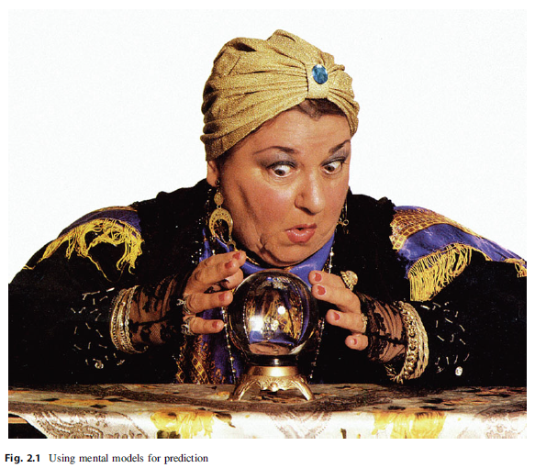
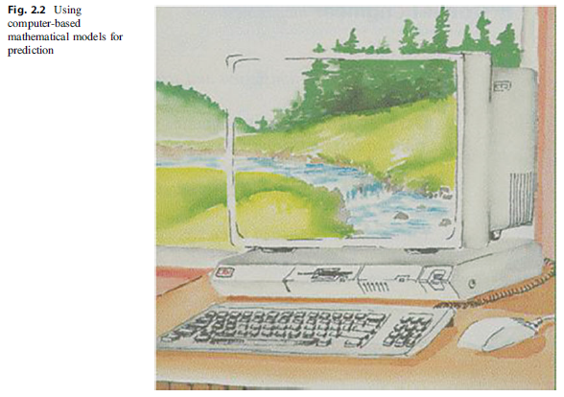
Modeling Water Resources Systems
Models = “Simplified Representations” of the real-world systems (실제 시스템의 단순화된 표현방법, 모델링을 하는 목적)
모델을 사용하는 이유 (목적) 예측: “내가 지금 내리는 결정이 실제로 어떤 결과를 가져올까?”
Qualitative information
& beliefs
Quantitative mathematical models (Mathematical simulation or
optimization models)

Slide 6
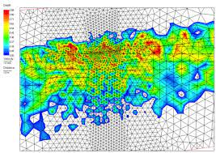
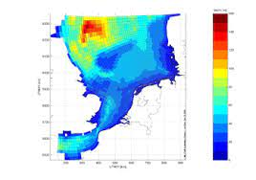
Modeling Water Resources Systems
Limitations with Modeling Approach
Complexity <복잡성> … Why?
Computational Limitations?
Hard to understand the multiple interdependent physical, biochemical, ecological, social, legal, and political (human) processes that govern the behavior of such water resource systems
Requires numerous approximations and assumptions
=> 해결하고자 하는 문제의 범위나 문제를 해결/모델링하기 위한 가정들을 명확하게 설정하는 것이 매우 중요함! (related to space variability & scaling in 23 UPHs)

Slide 7
Modeling Water Resources Systems
Challenges in Modeling
Challenges of Planners and Managers (의사결정자)
실제로 물 문제를 해결하는 사람 (정책을 만들고 정책을 시행)
Ex) 수자원공사, 한국수력원자력, 등등의 기관 소속
Challenges of Modelers
모델을 만들고 모델을 사용하여 수치적인 분석을 진행하는 사람
의사결정자나 실제 사용자들의 의견을 받아 이를 모델로 구현하는 역할
주로, 학계나 연구직에 종사하는 전문가가 많음
Challenges of Applying Models in Practice
실제로 물 문제를 경험한 사람
의사결정자나 모델을 개발한 사람들보다 상대적으로 전문 지식이 부족할 수 있음

Slide 8
***What constitutes WRS Models?***
*** Components consisting a Model ***
Parameters (매개변수): variables that are assigned KNOWN values
Decision Variables (결정변수): variables having unknown values that are to be determined by solving the model
Design variables: 저수지의 용량, 보의 높이 등 설계와 관련된 변수들
Operating variables: 저수지 방류량, 용수 배분량 등
State Variables (상태변수): variables that describe the state of the system
Constraints (제약조건): the conditions the system has to satisfy
(+) Objective Function (목적함수) (in case of optimization models): function to be optimized during the problem solving procedures

Slide 9
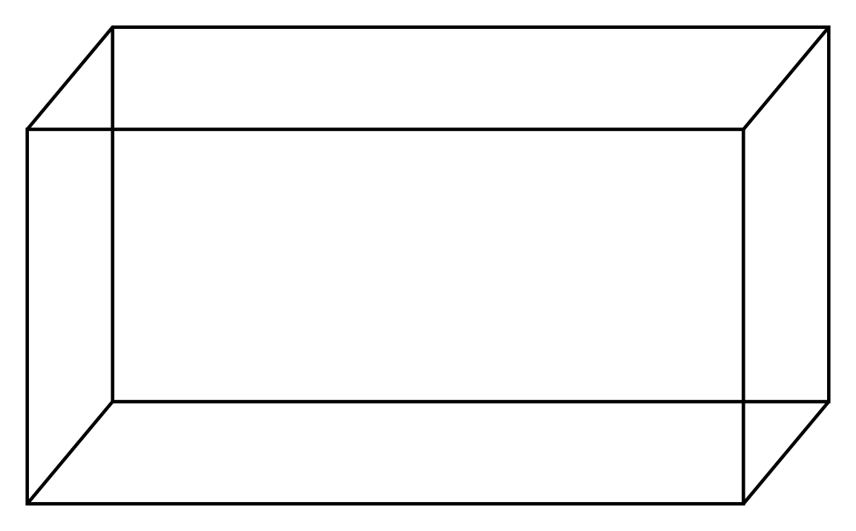






Example of the Model Formulation
$$W$$
$$L$$
$$C_{top}$$
$$C_{side}$$
$$H$$
$$C_{base}$$

Slide 10


Example of the Model Formulation
$$Minimize Cost$$
$$Cost=\left(C_{base}+C_{top}\right)\left(LW\right)+2(C_{side})(LH+WH)$$
Subject to:
Determine W, L, and H.
$$LWH≥V$$
Objective Function (목적함수)
Cost function, Loss function, Utility function 등으로 불릴 수 있음
계산 과정을 통해 반복적으로 계산되는 함수를 뜻함
Parameters (매개변수) = variables that are assigned known values
Decision Variables (결정변수) = variables that are to be determined by solving the model
Constraints (제약조건) = the conditions that the systems has to satisfy

Slide 11
Types of Water Resources Systems Models
Optimization Models
REQUIRES an objective function to be maximized/minimized
Solution = Values of ALL of Unknown Decision variables that satisfy the predefined constraints
Simulation Models: Answers “What if” questions
What will likely to happen under a particular design or operating policy?
Works well when there are only a relatively few alternatives to be evaluated (trial-and-error process)
How about Simulation-Optimization Models?

Slide 12
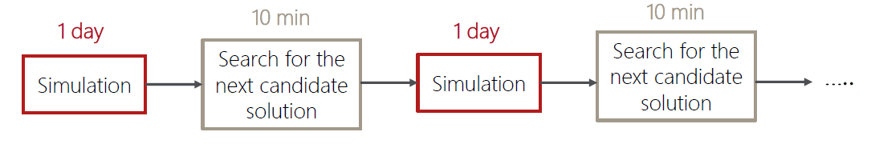
Types of Water Resources Systems Models
Simulation Optimization Models (Simulation/Optimization) (=Simulation-based optimization)
Integrates optimization techniques into simulation modeling & analysis (usually with stochastic objective functions)
Examples: Heuristic methods (genetic algorithms) & Dynamic programming models
Primary Limitation = Computational Expenses Simulation optimization is computationally expensive (Solution: Parallel Computing)

Slide 13
Examples of Water Resources Systems Models Applied in Practice (Industry)
US Army Corps of Engineers (미군 육군 공병대)- Hydrologic Engineering Center (HEC)
HEC-HMS (Hydrologic Modeling System)
Traditional hydrologic analysis procedures (event infiltration, unit hydrographs, hydrologic routing)
Continuous simulation (evapotranspiration, snowmelt, soil moisture accounting, runoff simulations)
HEC-RAS (River Analysis System)
1-D steady flow, 1&2-D unsteady flow calculations
Sediment transport/mobile bed computations
Water temperature & water quality modeling
HEC-ResSim (Reservoir Simulation)
Model reservoir operations for a variety of operational goals and constraints

Slide 14
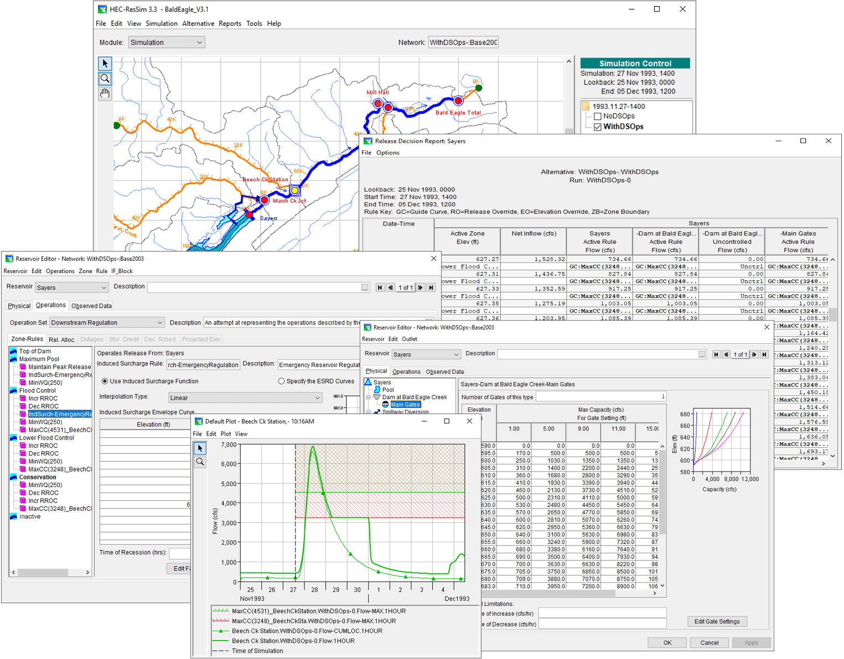
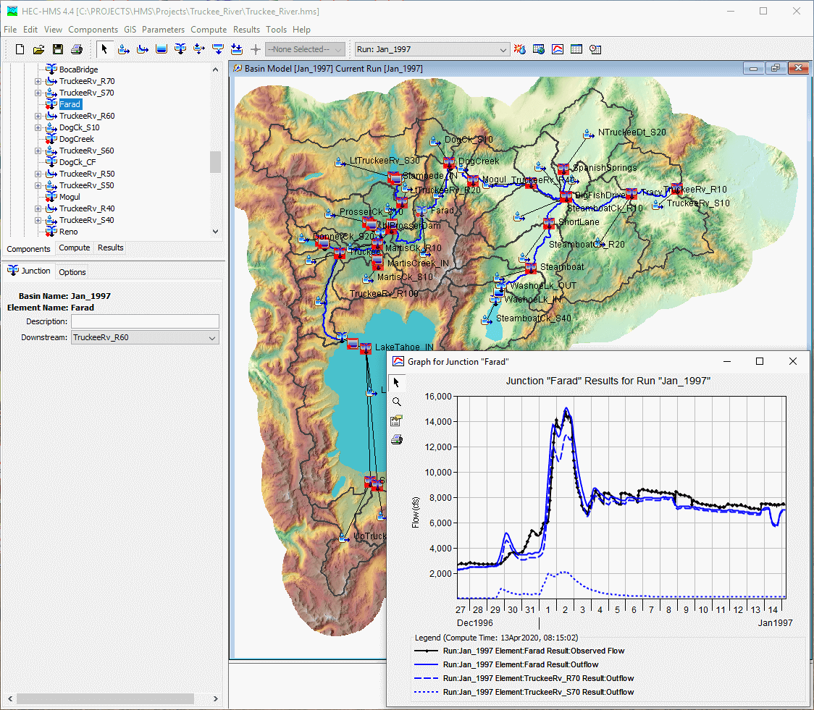
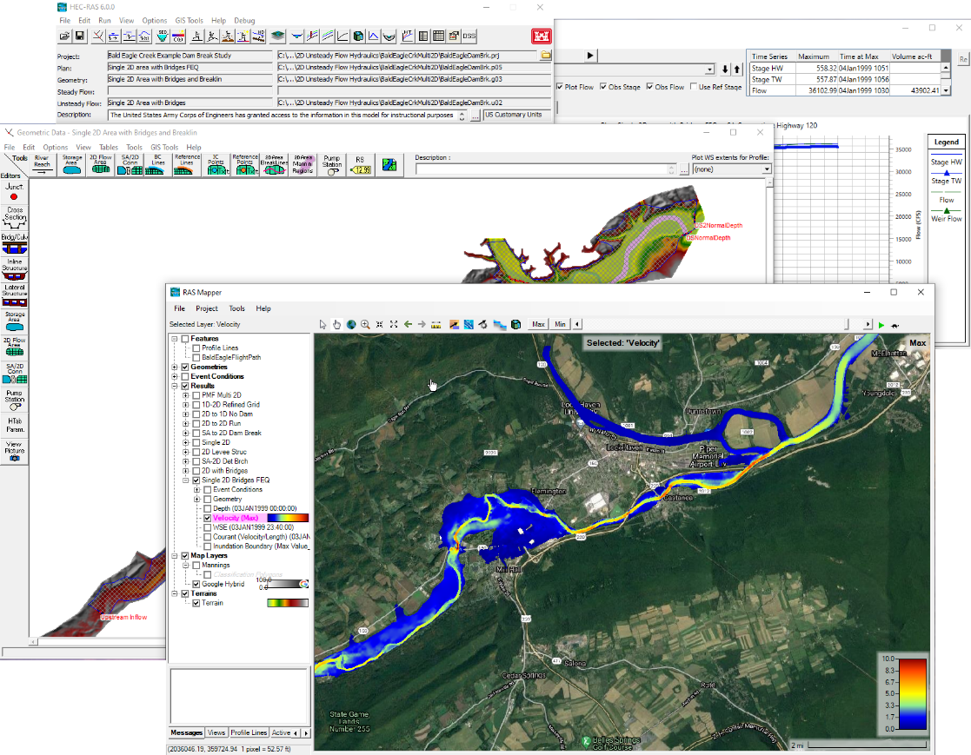
Examples of Water Resources Systems Models Applied in Practice (Industry)
https://www.hec.usace.army.mil /software/default.aspx

Slide 15
Modeling Water Resources Systems
Challenges in Modeling
Challenges of Planners and Managers (의사결정자)
실제로 물 문제를 해결하는 사람 (정책을 만들고 정책을 시행)
Ex) 수자원공사, 한국수력원자력, 등등의 기관 소속
Challenges of Modelers
모델을 만들고 모델을 사용하여 수치적인 분석을 진행하는 사람
의사결정자나 실제 사용자들의 의견을 받아 이를 모델로 구현하는 역할
주로, 학계나 연구직에 종사하는 전문가가 많음
Challenges of Applying Models in Practice
실제로 물 문제를 경험한 사람
의사결정자나 모델을 개발한 사람들보다 상대적으로 전문 지식이 부족할 수 있음

Slide 16
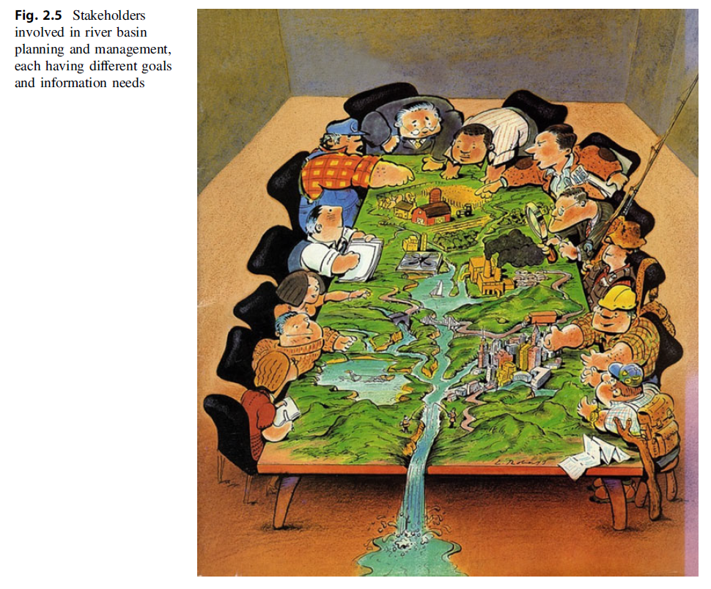

Slide 17
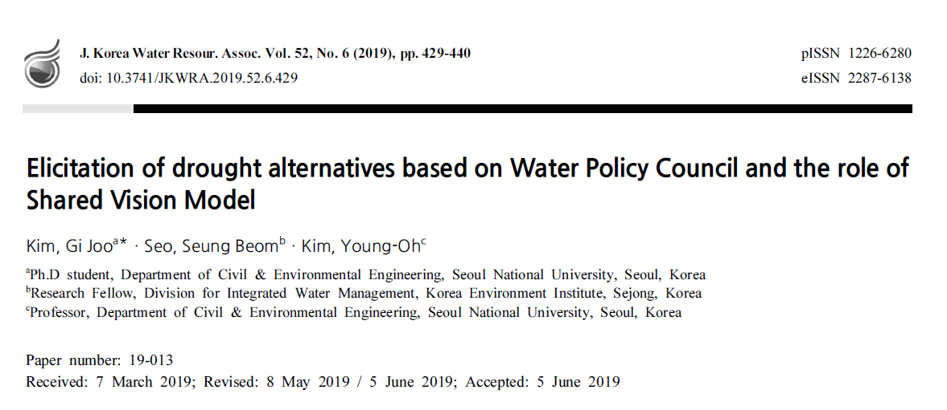
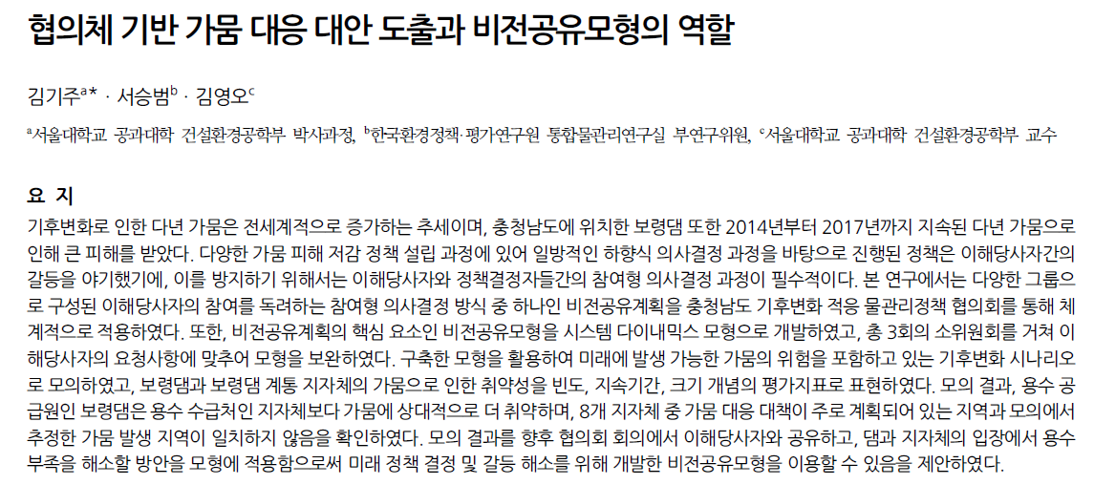
Modeling in the Real-world: Example
Application of Shared Vision Planning in Korea

Slide 18
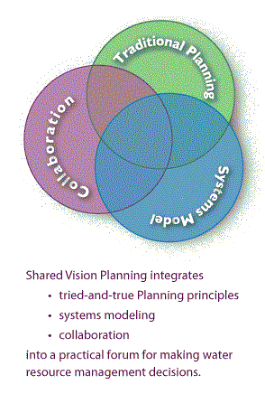
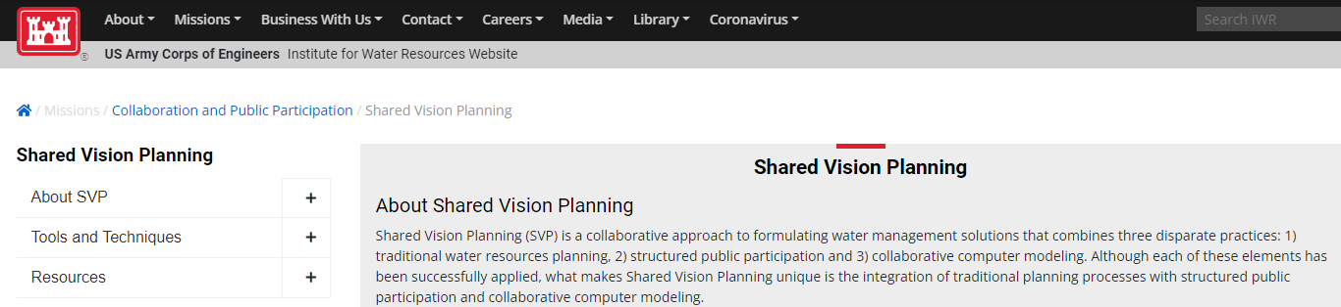
Modeling in the Real-world: Example
Shared Vision Planning (비전공유계획) (교재 p.65-67)
Type of an Interactive Model-building Technique
Stakeholders hardly believe in the model already built (and this is partially TRUE- you will see in the exercise)
Objective: Involving Stakeholders in Model Building Procedures in order to give them a feeling of ownership

Slide 19
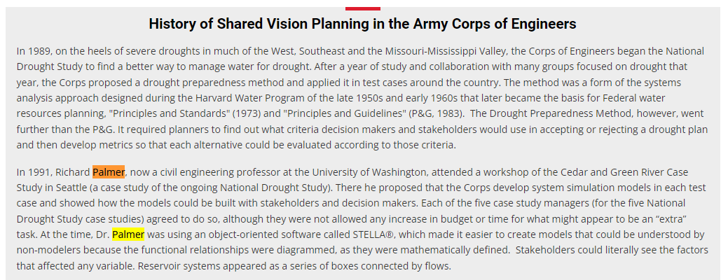
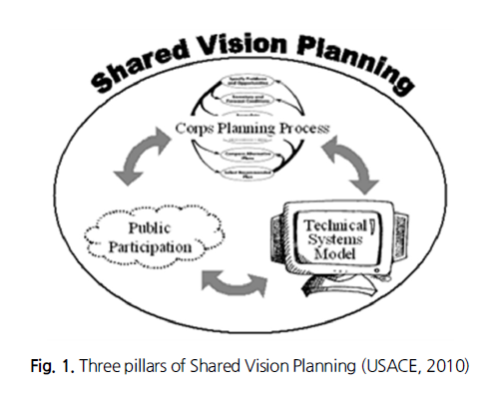
Modeling in the Real-world: Example
Shared Vision Planning (비전공유계획)
https://www.iwr.usace.army.mil/Missions/Collaboration-and-Conflict-Resolution/SVP/About-SVP/History-of-Shared-Vision-Planning/

Slide 20
Modeling in the Real-world: Example
충청남도 기후변화 적응 물관리정책 협의회
불확실성이 큰 기후변화 적응의 기본 철학 아래에서
다양한 이해관계를 가진 사람들이 투명한 정보를 공유하고 신뢰를 바탕으로 서로 배우며
비전을 만드는 시작 단계부터 대안을 선정하고 실현하여 평가하는 마지막 단계까지 전 과정을 함께 하여 합의를 이끌어내기 위함.
Timeline
2016-12-07 창립총회 개최
2017-09-21 1차 소위원회
2017-11-03 2차 소위원회
2018-07-25 3차 소위원회

Slide 21
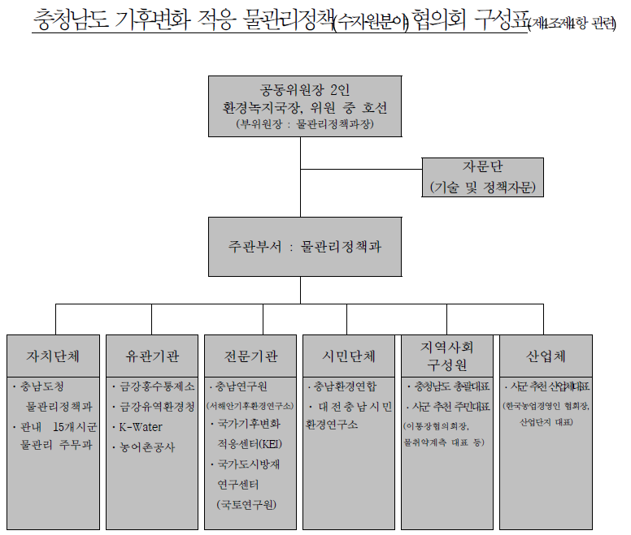
Modeling in the Real-world: Example

Slide 22
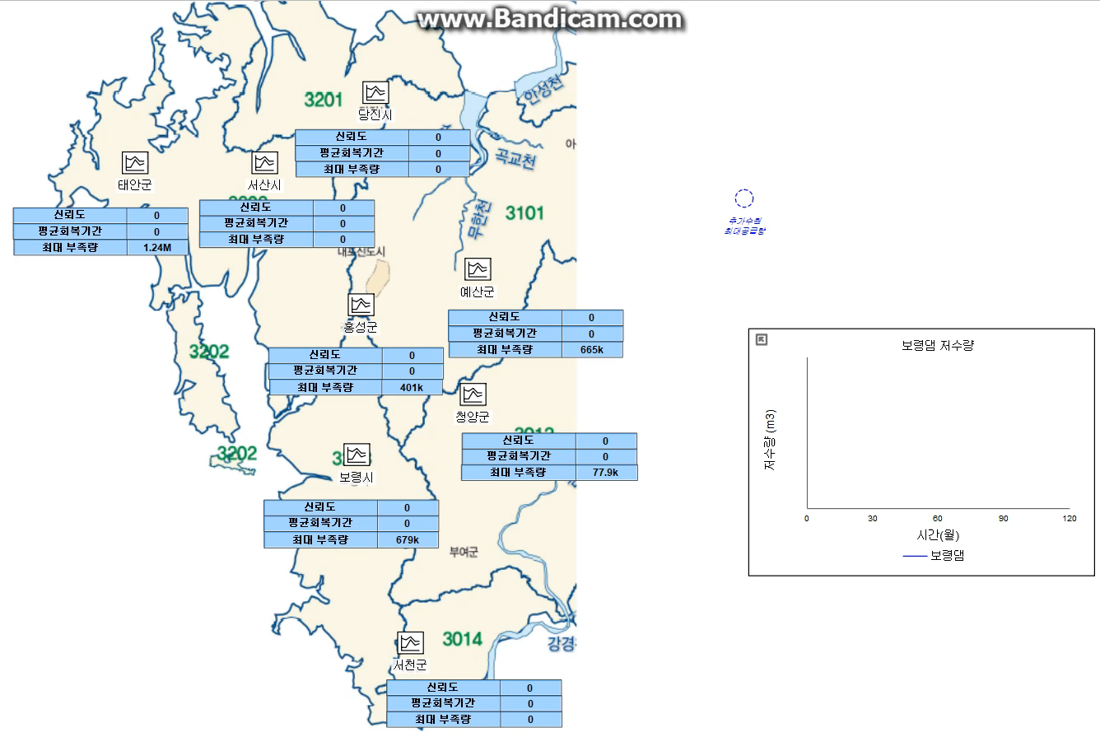
Modeling in the Real-world: Example
1차 소위원회 (2017-09-21) 사용 모형

Slide 23
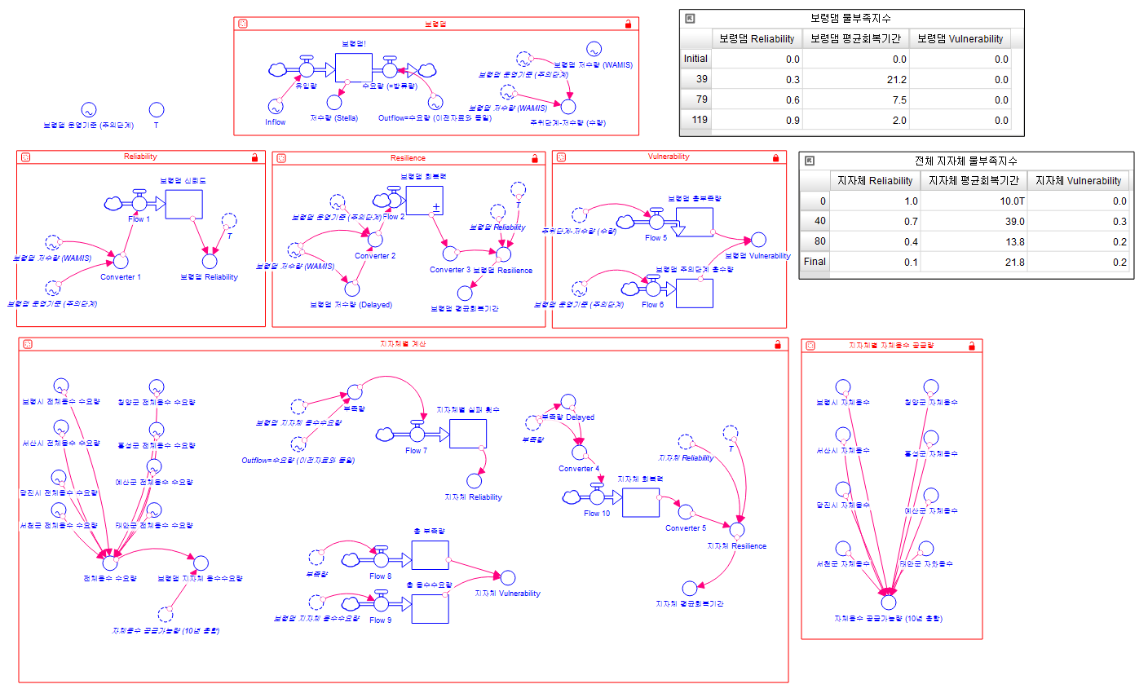
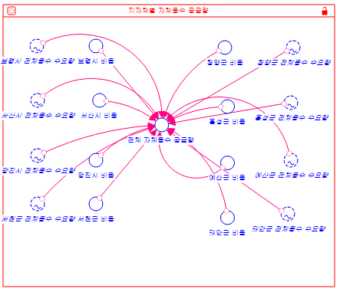
Modeling in the Real-world: Example
2차 소위원회 (2017-11-03) 사용 모형
보령댐
보령댐 물부족지수
성공 확률
회복기간
부족량
8개 시∙군 물부족지수
8개 시∙군 물부족지수 계산
8개 시∙군 지방상수원 비율

Slide 24
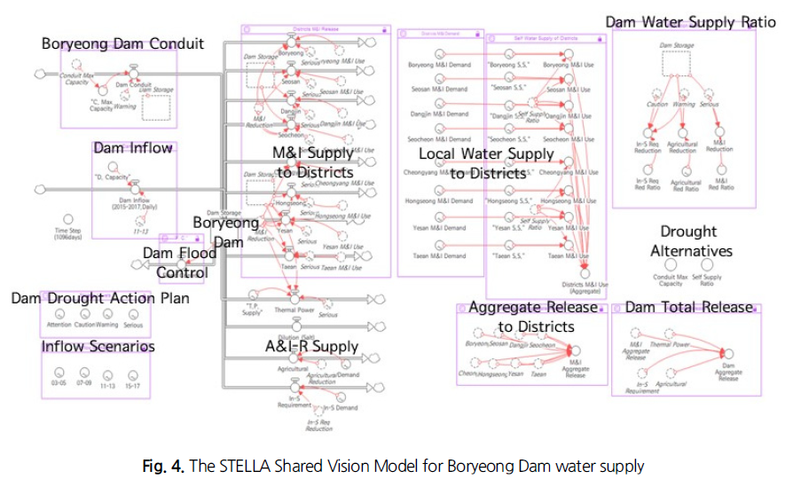
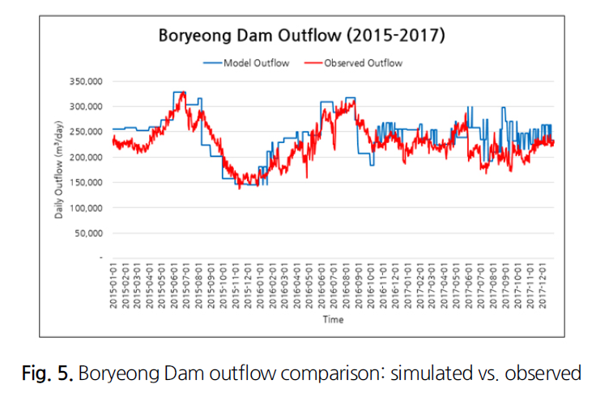
Modeling in the Real-world: Example
3차 소위원회 (2018-07-25) 사용 모형

Slide 25
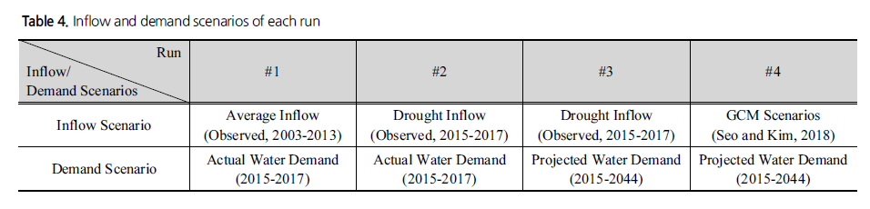
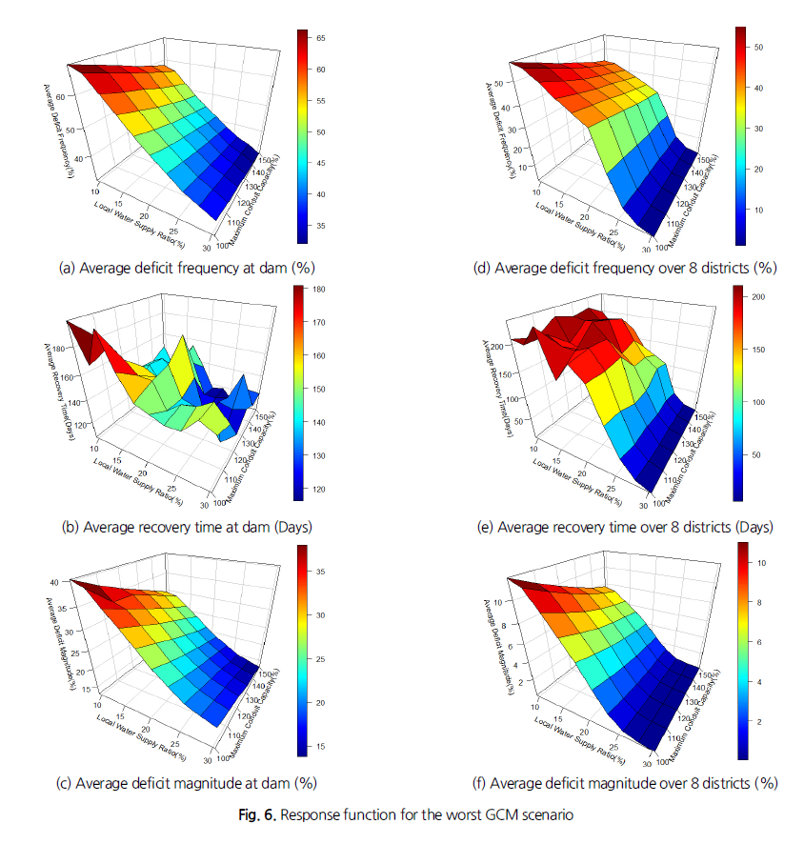
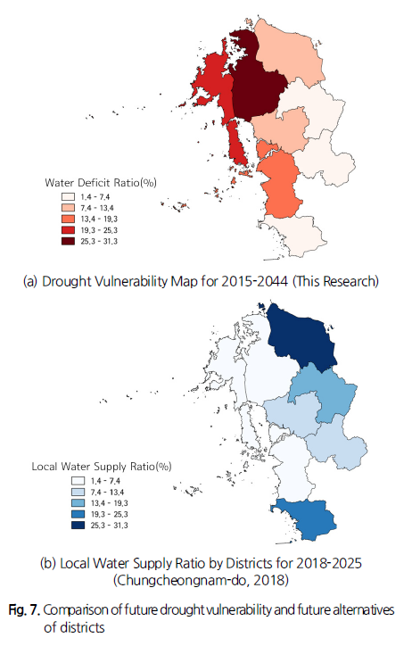
Modeling in the Real-world: Example
모형을 사용한 분석

Slide 26

Now, It’s Your Turn to build a model.
Build a reservoir simulation model assuming known inflow series $I_{t}$. What are the governing equations and the constraints? Assuming that you are the dam operator, what might be a possible objective function? How about when you are a water user? Which objective between the two is more important? (refer to the equations in slide # 10).

Slide 27
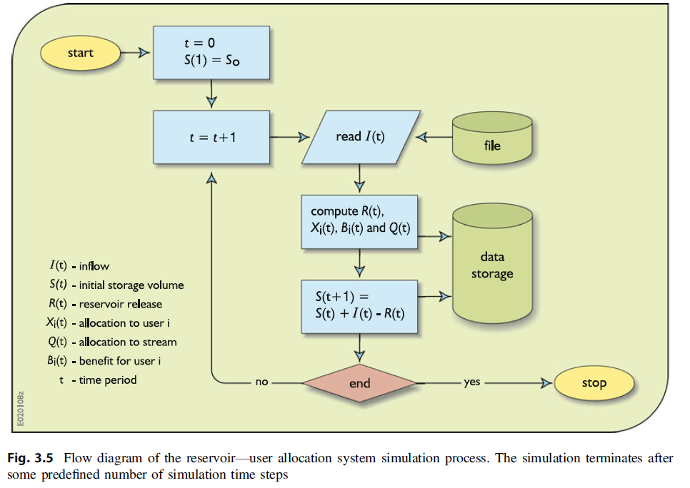
** Flow Diagram of a Reservoir Simulation Model **

Slide 28
Conclusion of Lecture 02
Modeling Water Resources Systems
Models = “Simplified Representations” of the real-world systems
We use models to predict (or answer “what if” questions) possible consequences (especially quantitative) of our actions
Types of Water Resources Systems Models
Optimization, Simulation, Simulation/Optimization Models
Examples of Water Resources Systems Models
HEC-HMS, HEC-RAS, HEC-ResSim Models
Shared Vision Planning Model

Slide 29
Future Schedule
다음 주 강의 (2022-03-22 화요일 17:00-19:50)
Lec 03: Introduction to Conventional Optimization Models (DP&LP) Part I
General Concepts of Optimization Models
Concepts of Linear Programming Models (LP)
Examples of Problem Solving with LP Models
Concepts of Dynamic Programming Models (DP)
Examples of Problem Solving with DP Models
Real-world Applications of Traditional Optimization Models
Assignment #1 DUE Before Class on Mar-22 (출력본 제출)
Quiz #1 on Mar-29 // Datacamp #1 Due Mar-29

Slide 30
Real-world Reservoir Simulation
Assignment #1의 4-5번 문제를 엑셀로 수행.
What are the key assumptions you made in building the model?
How will you enhance the model’s practicality? (어떻게 모델을 더욱 현실과 비슷하게 개선할 것인지?)

